Slide 1
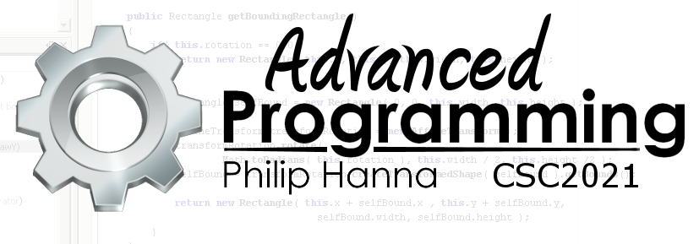
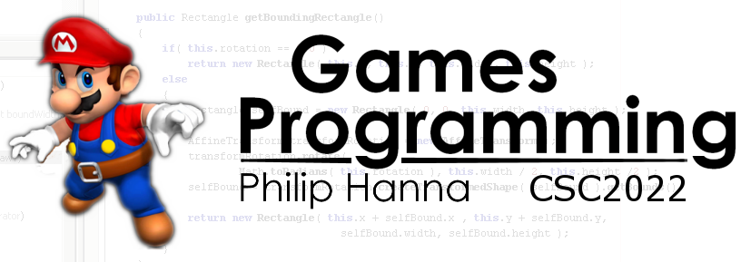
Dynamic Memory Allocation
Part 2 – Garbage Collection and Object Pools

Slide 2
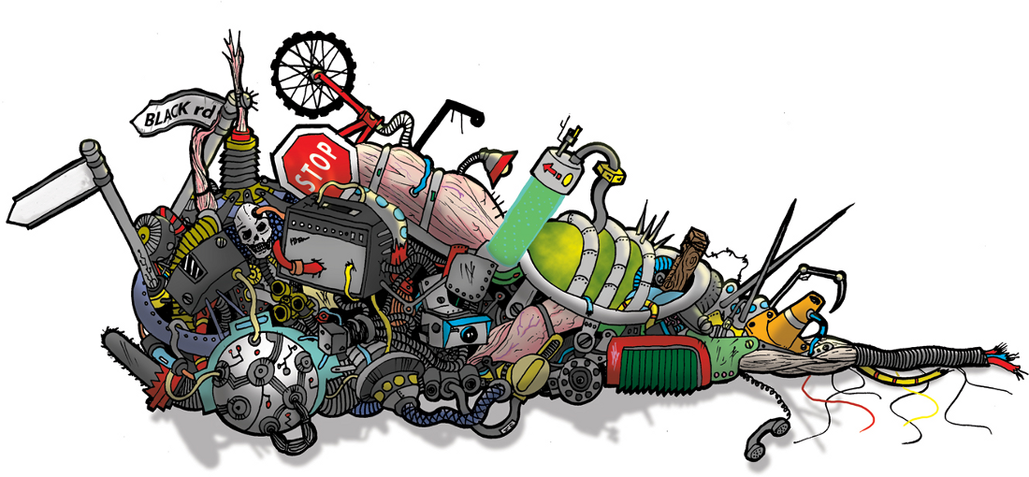
Garbage Collection

Slide 3

In managed languages (e.g. Java or C#) the programmer does not need to free memory or worry about static/dynamic allocation, etc. Instead this process is managed by the virtual machine (VM).
Managed languages use a low-priority background garbage collector thread (GC) to periodically scan memory, deleting objects and freeing memory if they are no longer used.
Notes:
Aside: Garbage Collection
When using managed languages such Java or C# you never had to worry about allocating or freeing memory, dynamic or static allocation, etc. Instead this was something that the VM did on your behalf.
An important element of a managed language is the garbage collector (GC) – a low-priority background thread that periodically scans memory, deleting objects and freeing memory if they are no longer used.

Slide 4
Design Time:
Require all created objects to extend a common base (e.g. Object) that permits a GC to mark if the object is in use. Also ensure all arrays are wrapped and extend the base class.
Use reference counting smart pointers.
One common GC approach is mark and sweep where every defined pointer is periodically scanned and objects marked. Unmarked objects are considered to be not in use and are freed.
This might be done in C++ as:
Run Time:
Periodically run a GC process within a thread to follow registered pointers and mark objects that are in use.
Free any objects that are not used.
Notes:
One common approach is mark and sweep where the GC periodically scans every defined pointer in your program and ‘marks’ the memory that is referenced by that pointer. Once done, any heap memory that has not been marked is considered not in use is freed.
This could be done in C++ as:
Design:
Introduce a base class (e.g. Object) that permits a GC to mark if the object is in use. Ensure that all created objects extent the base class. Further ensure that arrays, etc. also ‘extend’ the base class (i.e. arrays are wrapped). Note: This is what happens in C# and Java where all objects have a common base class.
Use reference counting smart pointers
Runtime:
Register all smart pointers and objects (returned via new) with the GC.
Periodically run a GC process within a thread to follow registered pointers and mark objects that are in use. Free any objects that are not used.

Slide 5

Advantages of using a GC include:
no memory leaks (in principle)
frees programmer from house-keeping tasks.
The key disadvantage is that the programmer can take the GC for granted and write sloppy code that creates a lot of short-lived temporary objects, thereby imposing a massive performance hit on the GC.
Notes:
Advantages of the GC are: no memory leaks (in principle), frees programmer from house-keeping tasks.
The key disadvantage is that the programmer can take the GC for granted and write sloppy code that regularly creates a lot of temporary objects thereby imposing a massive performance hit on the GC that will slow down the entire program.

Slide 6

Object Pools

Slide 7
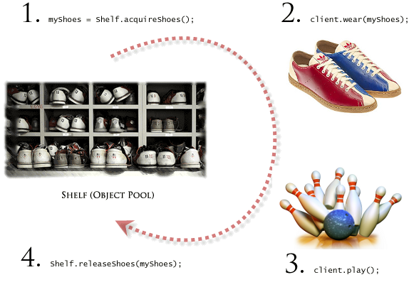
Object Pools
Object pools provide an effective ways of managing a large number of temporary objects that can be used and then recycled without actually being deleted.
Object are checked out of the pool, used and then released back into the pool so they can be reused when needed.
Pools may be of a fixed size or grow dynamically as needed.
Notes:
Object pools provide an effective ways of managing a large number of temporary objects that can be used and then recycled without actually being deleted.

Slide 8

Key takeaways:
Unlike C# or Java, C++ has no automatic garbage collection. The programmer must ensure dynamically allocated memory is released.
There is a danger of a memory leak if memory is allocated with also being released.

